Slide 1
Problem Statement -Protecting user password keys at rest (on the desk)

Slide 2
Unique Idea Brief (Solution) Unique Idea: File Splitting and Merkle Tree Verification -File Splitting for Enhanced Security: Goal: Implement a mechanism to split the original file into smaller chunks before encryption. Implementation: Divide the file into fixed-size chunks (e.g., 1MB each). Encrypt each chunk individually using AES in CFB mode with a unique initialization vector (IV) for each chunk. Store these encrypted chunks in a structured manner. -Merkle Tree Construction for Integrity Verification: Goal: Create a Merkle Tree using the encrypted chunks to ensure data integrity during decryption. Implementation: Compute cryptographic hashes (e.g., SHA-256) of each encrypted chunk. Construct a Merkle Tree from these hashes, where each leaf node represents a chunk hash. Build internal nodes by hashing pairs of child nodes recursively until a single root hash is obtained.

Slide 3
Features Offered The provided Python code implements a basic file encryption and decryption application using AES encryption in CFB mode and PBKDF2 for key derivation. Here are the features and functionalities offered by this application: Features Offered: .Graphical User Interface (GUI) .File Operations: -Encrypting files -Decrypting files .Error Handling .Security Considerations .User Feedback .User Input Validation

Slide 4
Process flow The provided Python code implements a file encryptor and decryptor application using tkinter for the GUI and cryptography library for AES encryption with PBKDF2 key derivation. Here’s a detailed explanation of the process flow: Initialization (_init_ method of FileEncryptorDecryptorApp) .GUI Initialization .Widgets Setup .File Selection (select_file method) .Key Derivation (derive_key method) .ncryption (encrypt_file method) .Decryption (decrypt_file method) .Action Methods (encrypt_action and decrypt_action) .Main Program Execution (if _name_ == "_main_":)

Slide 5
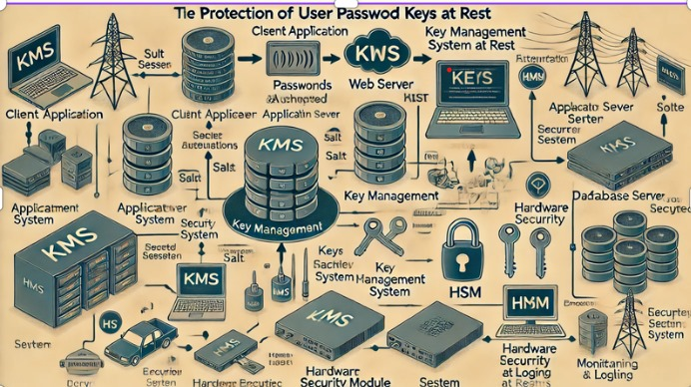
Architecture Diagram

Slide 6
Technologies used -Python: The programming language used for the entire application. -tkinter: The standard GUI toolkit in Python's standard library. It's used for creating windows, buttons, labels, and handling user input. -cryptography library: .PBKDF2HMAC: Used for deriving a secure encryption key from a password and salt. .AES: Advanced Encryption Standard used for encrypting and decrypting file contents securely. .modes.CFB: Cipher Feedback mode, a mode of operation for block ciphers like AES, used for encrypting data. .hashes.SHA256: SHA-256 hash function used in the key derivation process. -os module: Used for operating system-level functionalities such as file operations and generating random bytes. -messagebox: Part of tkinter, used to display information, warning, and error messages to the user. -filedialog: Part of tkinter, used to open a file dialog for file selection.

Slide 7
Team members and contribution: -Team name : Team Solo -Team members :Kaniki Chakradhar Reddy -Mail: ckaniki@gitam.in -College : Gitam University

Slide 8
Conclusion
This Python application uses the `tkinter` library to create a graphical user interface (GUI) for file encryption and decryption, and the `cryptography` library for performing the encryption tasks. Users can choose a file, enter a password, and then either encrypt or decrypt the file. The encryption process involves creating a random key, deriving another key from the password, and encrypting the file contents. Decryption involves using the password to retrieve the key and decrypt the file.
The interface includes:
- A field to select a file.
- A field to enter a password.
- Buttons to start the encryption or decryption process.
The code is mostly well-written but contains a couple of minor errors that need correction:
- The constructor method should be named `__init__` instead of `_init_`.
- The main function name should be `__name__` instead of `_name_`.
Additionally, the user interface could be improved to handle errors better and to look more appealing.

